Slide 1

Plotting a Graph using MATLAB GUI
COMP ENGR. LAB
ECEG 2110
Nahiyan Bin Noor

Slide 2
Simple Graph
Take an Axis from the Component Library.
Add a push button and rename it as Plot
Go to callbacks from push button and add a new Callback.

Slide 3
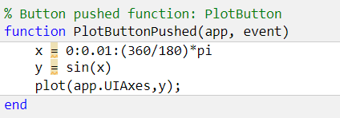
Simple Graph
You can use different color and format of the plot if you want.
Try with different function y = f(x)

Slide 4
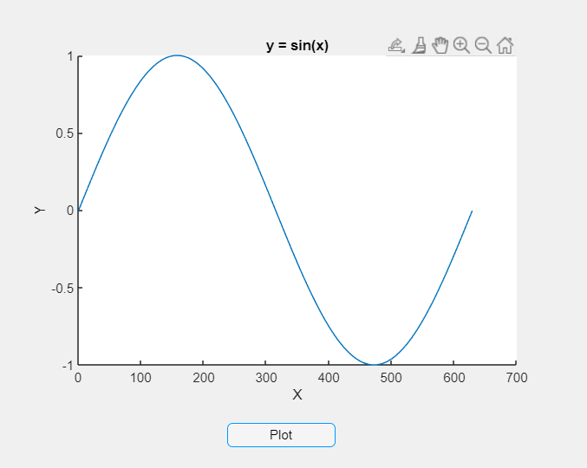
Simple Graph
Now run the app and press on push button.
You can see the plot

Slide 5

Simple Graph
How can we get the graph before pressing on push button?

Slide 6
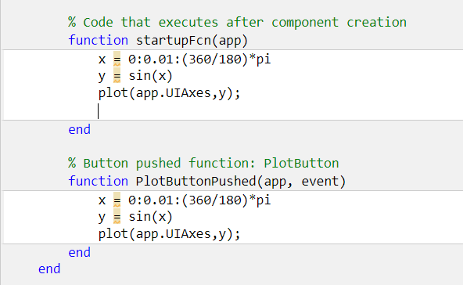
Startup Function
Startup Function Callback

Slide 7
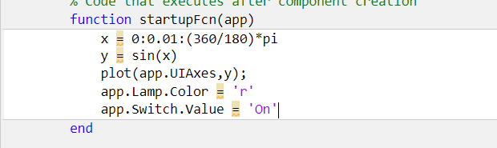
Startup Function
Add a lamp and a switch in the graph
At the starting the light should be red and the switch should be on.
Edit your startup function for that.

Slide 8
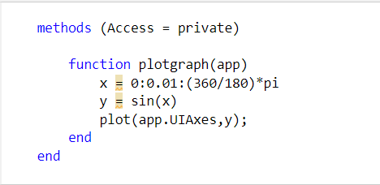
Helper Function
Click on “Function” and add a public or private function.
It will create a method and a function.

Slide 9
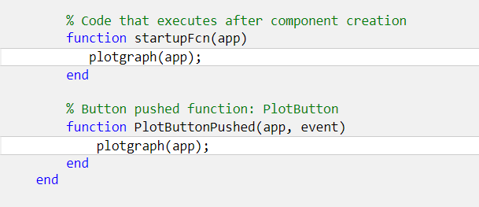
Calling the Helper Function
Now just call the function inside startup function and Callback.
If you don’t want to see the graph at the starting of the app then just comment out the startup function by %plotgraph(app);

Slide 10
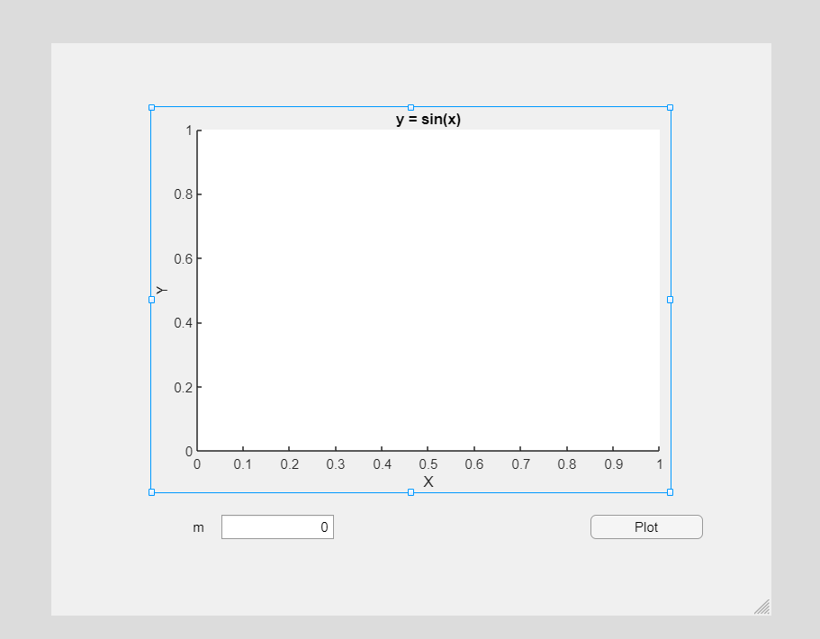
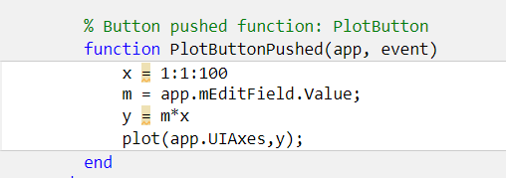
Same Callback for Multiple Components
Callbacks → Select existing callback → set the name of existing callback

Slide 11
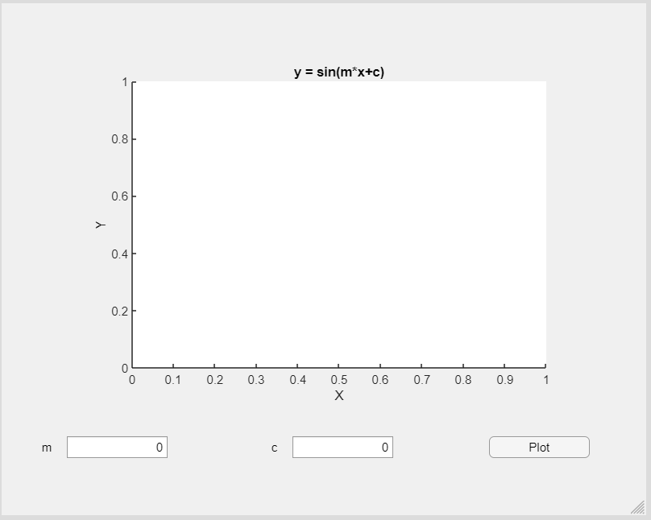
Plot with Multiple Variable
Add a public/private helper function and edit that.

Slide 12
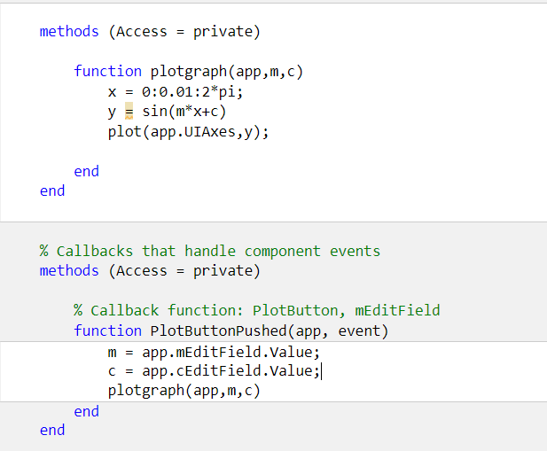
Plot with Multiple Variable
Add a public/private helper function and edit that.

Slide 13

Question
What is the effect you can see if you change the value of m and c? Explain.

Slide 14

Thank you

